Slide 1
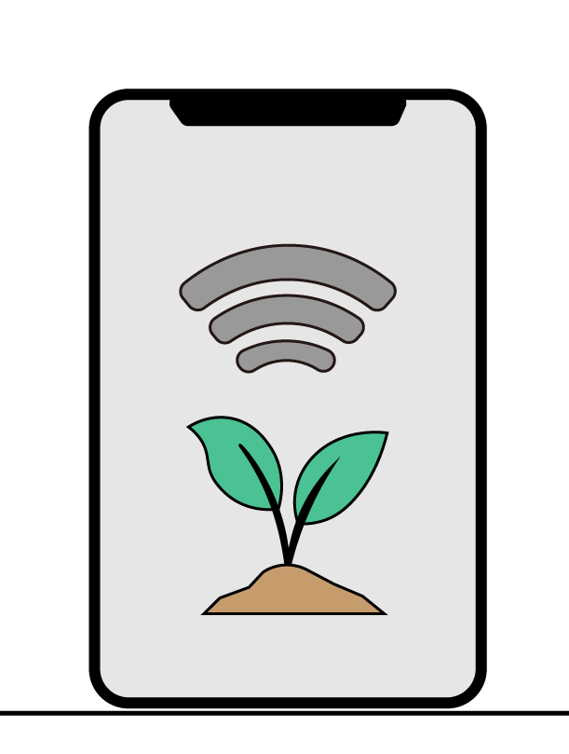
Smart Farmers iot enabled smart farming
Team Id: PNT2022TMID41287
Team Leader: Mithun Srinivasan S
Team members:
Ravin. G
Ajith Kumar. S
Arun Kumar. M
Mentor: Dr G. Dinesh Kumar

Slide 2
Introduction
In India, agriculture is considered a primary livelihood for most of the population, which can never be underestimated.
Agriculture has existed for thousands of years in our country with their own traditional methods
In India, Farmers still use the traditional farming method because they lack the resources to use modern techniques.
Though this world developed a lot but agriculture in India is not changed that far

Slide 3
Our project
Our vision is to reduce burdens of farmers by simplifying their works through modern technologies.
Our project is to build a user-friendly system which can be used by farmers to have better understanding about the field by monitoring the field parameters and motor control on their handheld device.
We used Internet Of Things to build a system which is capable of reading field parameters and can publish several information to the handheld device of the farmer.

Slide 4
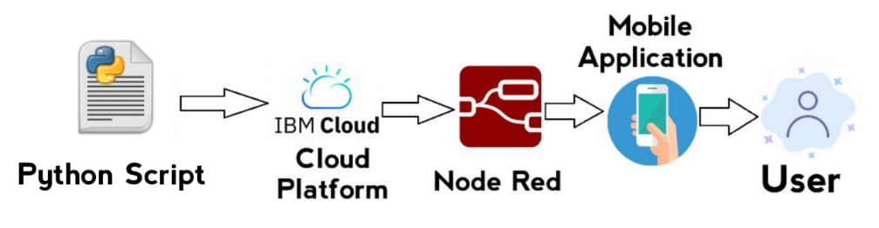
Block Diagram

Slide 5
methodologies
Python Script
IBM Watson Cloud
Node-Red
MIT app Inventor

Slide 6

Python script
We use Python Script to generate random values for parameters like Soil Moisture, Temperature, Humidity, pH level
To publish values to IBM cloud
To receive commands from mobile app

Slide 7
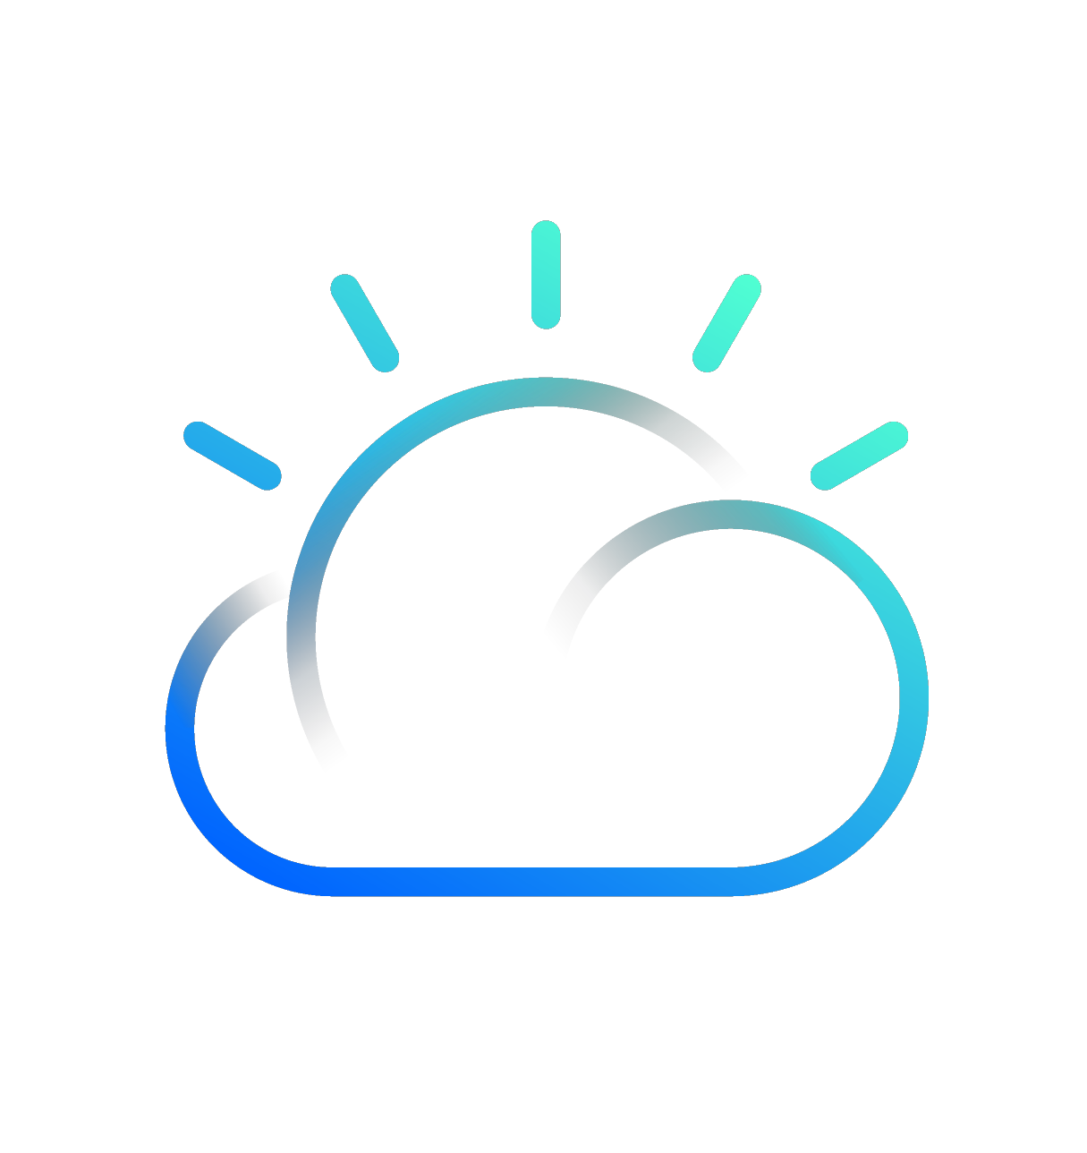
IBM Watson Cloud
What is IBM Watson Cloud?
How we used in your project?
To store data send By python code
To pass data from python script to mobile app through node-red
To pass commands From mobile app to python script
IBM cloud computing is a set of cloud computing services for business offered by the information technology company IBM

Slide 8

Node - red
What is Node–Red?
How we used in your project?
Node-RED is a flow-based development tool for visual programming developed originally by IBM for wiring together hardware devices, APIs and online services as part of the Internet of Things.
To connect IBM Watson cloud to MIT app inventor
To pass data from IBM Watson to mobile app
And to pass commands from mobile app to python script through IBM cloud

Slide 9

MIT APP INVENTOR
What is MIT App inventor?
How we used in your project?
To create a user friendly interface for mobile app
To print field parameters on the mobile app
To have a user credential login
To have a command button to pass command to python script
MIT App Inventor is an intuitive, visual programming environment that allows everyone to build fully functional apps for smartphones and tablets.

Slide 10
Project Flow
Python Script
To generate random values for parameters like Soil Moisture, Temperature, Humidity, pH level. And To publish values to IBM cloud
IBM Cloud
To store data send by python code. And to pass data from python script to mobile app and vice versa
Node-Red
To connect IBM Watson cloud to MIT app inventor. And to pass data on both directions
Mobile App
To create a interface for mobile app to print data

Slide 11

Demonstration video

Slide 12
Challenges
We faced
Challenges Ahead
Creating and connecting various services
During data collection from the farmers – literature survey from farmers
While building login credentials in Mobile App
Cost efficiency of the hardwares
Availability of project on market

Slide 13
References
Smart farming using IoT, a solution for optimally monitoring farming conditions https://www.sciencedirect.com/science/article/pii/S1877050919317168
IOT based smart agriculture system https://ieeexplore.ieee.org/document/8538702
Design and implementation of a connected farm for smart farming system https://ieeexplore.ieee.org/abstract/document/7370624
IOT based monitoring system in smart agriculture https://ieeexplore.ieee.org/document/8081906
IOT based smart agriculture monitoring system https://ijritcc.org/index.php/ijritcc/article/view/193
IoT based smart agriculture https://www.academia.edu/65409363/IoT_based_Smart_Agriculture
IoT-enabled smart agriculture: architecture, applications, and challenges https://www.mdpi.com/2076-3417/12/7/3396
IoT based smart farming system http://www.jetir.org/papers/JETIR1704008.pdf
Smart farming: The future of agriculture Smart Farming: The Future of Agriculture (iotforall.com)

Slide 14

THANK YOU

